Slide 1
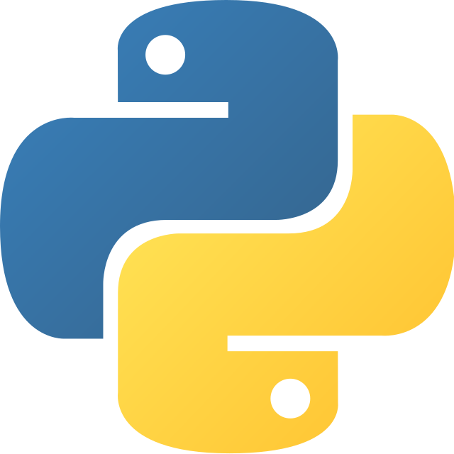
Step into python
Lection 2: Where we can start?

Slide 2

Agenda
1
Python shell
2
Python scripts
3
Python modules
4
How to install python packages
5
Virtual environments?
6
Conclusion

Slide 3
Python shell: what is it?
Python – is an interpreted language, which means the source code of a Python program is converted into bytecode that is then executed by the Python virtual machine.
So, if it is an interpreted language, python has a shell, where we can execute any command, which we need.
The Python Shell is the interpreter that executes your Python programs, other pieces of Python code, or simple commands.
So, basically, this is where you can execute python commands.

Slide 4
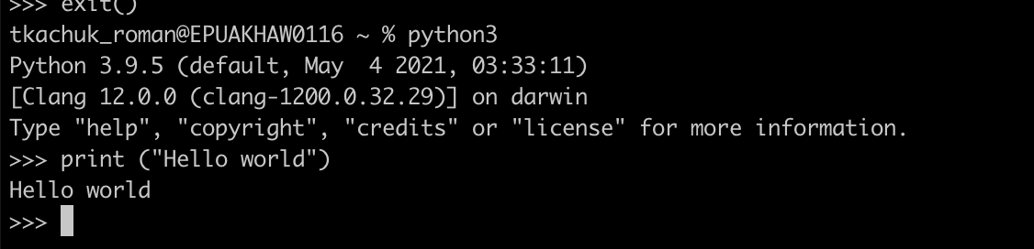
Python shell: how to use it?
First of all, we can execute it by executing python3 command in your default terminal.
After shell was started, you can try to run some commands (as the example – hello world command):
Hint: to exit type exit() command.

Slide 5
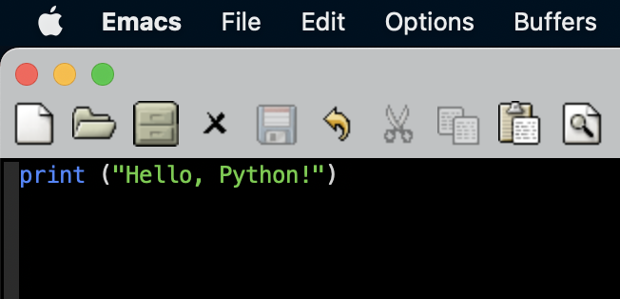
Python scripts: just next step out of shell
Python script, especially – is a list of commands, which can be executed from file.
To check this out, you can create simple file in your favorite editor with name hello.py.
There, I would suggest you insert print (“Hello python!”) text.

Slide 6
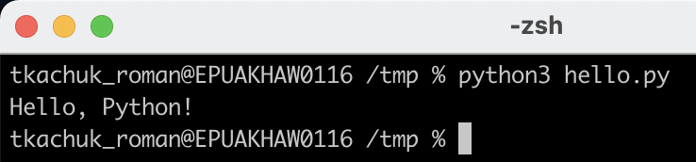
Python scripts: just next step out of shell
Now, as you saved the file, let’s test out and run the script (Linux users can use any terminal they want, Mac OS users I would suggest Iterm2, Windows users – cmd at your service!).

Slide 7
Python modules: simplifying the life?
Simply - A file containing a set of functions you want to include in your application, as a separate ”pack” of code.
Module – is the best way to split all your code by easy to edit independent pieces. Using modules can make your life easier.

Slide 8

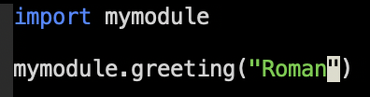

Python modules: How to use?
At first create file with functions you need (for example file name is mymodule.py):
Next, let’s use it in our program (same directory, file program.py):
And for now, we can run our program with python!

Slide 9
Python modules: Well… explanation?
At first, our module – is just a regular file, which contains functions, that can be used in various parts of our application.
Next, in order to use it we should add magic import command, which add all code from provided file (without .py in the end). So as result all functions from mymodule.py can be used in our main application.
As result, after running application, function greeting was used from module.
Remember: Modules are cool!

Slide 10
Python packages installation
By using python with modules, you can find that biggest part of the functionality were given by modules. Basic question that we want to ask: are there any already existing packages, which can be used? And answer is – yes!
Python pip – is a powerful package manager, which is used to install various packages with all required modules.
Easiest way to check, that pip exist – just try to run pip3 –version. If the command wasn’t found – just install it by following instructions: python3 -m ensurepip --default-pip – for mac os/linux py -m ensurepip --default-pip – for Windows (All instructions was taken from here)

Slide 11
Python virtual environments
Virtual environment – is a “container”, where you can install packages without affecting host operating system.
It is used widely to perform a multi-project development, where every project requires very special versions of packages.
By our learning program, we will use them much sooner, when additional packages will be required.
But you can read more about them on official documentation website.

Slide 12
Conclusion

Slide 13
Well…
You can use shell and script files in order to develop python applications.
You can create modules to separate application business logic and made programming more comfortable.
In order to use already existing modules, you can use pip – powerful tool to download packages.
Virtual environment of the python help keeping your host operation system clean and tidy.

